Slide 1


RESIDENT AND CLIENT SERVICES
CATEGORY
♦♦♦

Slide 2

CITY OF GLENDALE COMMUNITY
HOUSING DIVISION
GLENDALE, ARIZONA
Stephanie Small, Community Services Director
  Community Services Nexus
CITY OF TEMPE HOUSING SERVICES DIVISION
TEMPE, ARIZONA
Naomi Farrell, Director, Human Services
  Tempe Housing Workforce Development
  LeVon Lamy, Marie Raymond

Slide 3
PARAGOULD HOUSING AUTHORITY
PARAGOULD, ARKANSAS
David Lange, Executive Director
  Backpacks for School Program

Slide 4
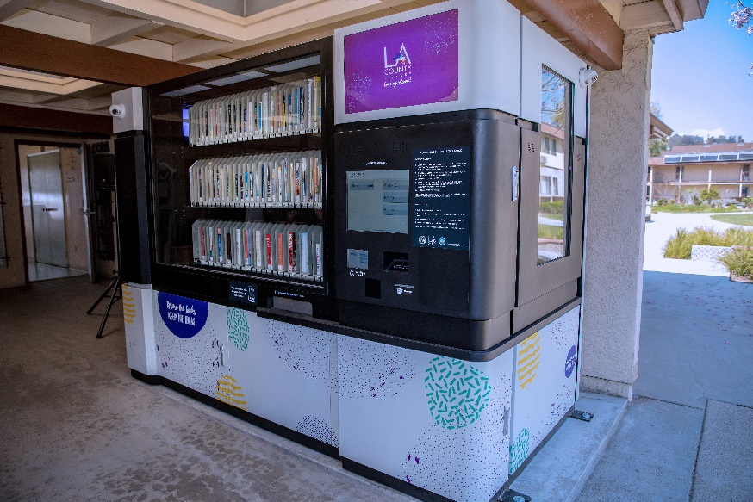
LOS ANGELES COUNTY
DEVELOPMENT AUTHORITY
ALHAMBRA, CALIFORNIA
Emilio Salas, Acting Executive Director
  Automated Library Services in Public Housing
  Emergency Response Unit: Woolsey Fire
  Darlene Aikens, Stacey Dawson, Craig Woods

Slide 5

LOS ANGELES COUNTY
DEVELOPMENT AUTHORITY
ALHAMBRA, CALIFORNIA
Emilio Salas, Acting Executive Director
  Modernization Space for Public Housing Youth Programs
  Twima Earley
  Moving On: A Pipeline to Permanent Housing
  Luisa Cardenas, Norma Contreras, Adriana Ruiz

Slide 6
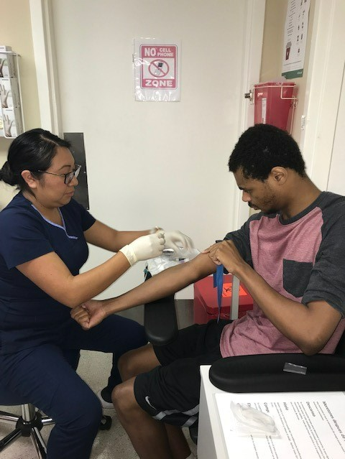

LOS ANGELES COUNTY
DEVELOPMENT AUTHORITY
ALHAMBRA, CALIFORNIA
Emilio Salas, Acting Executive Director
  Newly Opened Health Clinic in Public Housing
  Public Housing Youth Taking Flight in Aviation

Slide 7

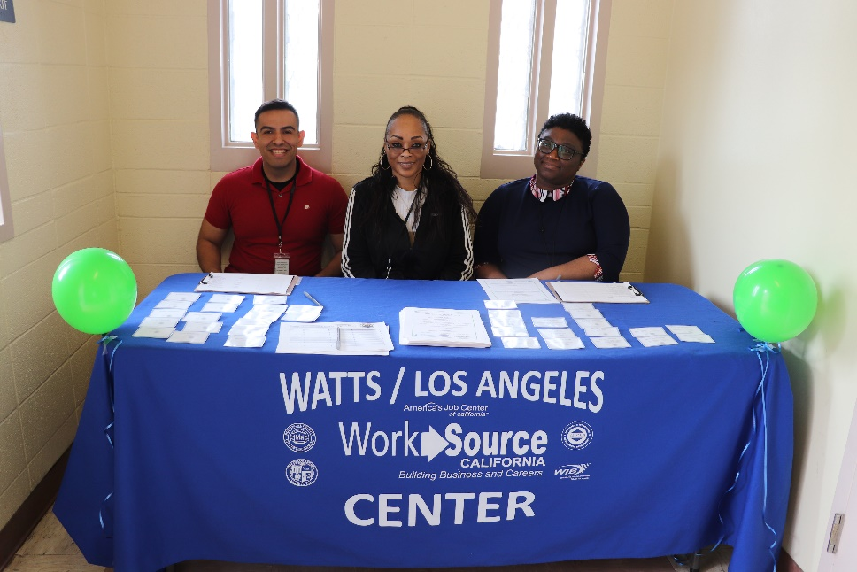
FRESNO HOUSING
FRESNO, CALIFORNIA
Preston Prince, Executive Director
  Summer Tech Camp
HOUSING AUTHORITY OF THE
CITY OF LOS ANGELES, CALIFORNIA Douglas Guthrie, President/CEO
  HACLA-Los Angeles Reconnections Center Academy 2.0

Slide 8
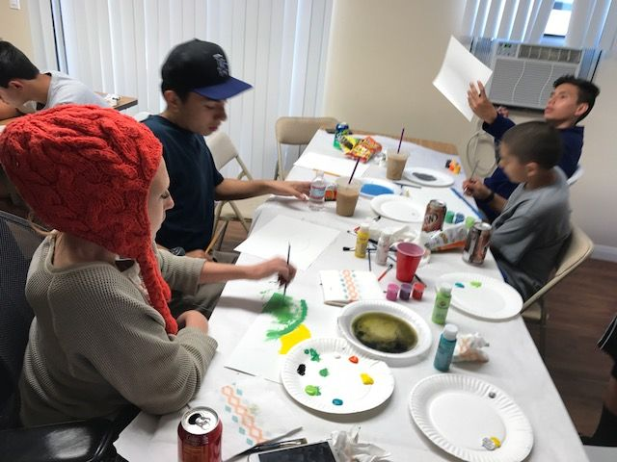

AREA HOUSING AUTHORITY OF THE
COUNTY OF VENTURA
NEWBURY PARK, CALIFORNIA
Michael Nigh, Executive Director
Art From The Heart
CITY OF OXNARD DEPARTMENT OF HOUSING
OXNARD, CALIFORNIA
Emilio Ramirez, Housing Director
Oxnard Housing Multi-Service Center

Slide 9
COUNTY OF SAN DIEGO HOUSING AUTHORITY
SAN DIEGO, CALIFORNIA
David Estrella, Director, County of San Diego
Housing and CD Services
    Reducing Returns to Homelessness & Incarceration
SAN DIEGO HOUSING COMMISSION
SAN DIEGO, CALIFORNIA
Richard C. Gentry, President/CEO
  SDHC Bridges to Career Opportunities

Slide 10
UNISON HOUSING PARTNERS
WESTMINSTER, COLORADO
Peter LIfari, Executive Director
  Family and Community Vitality at Unison
NEW BRITAIN HOUSING AUTHORITY
NEW BRITAIN, CONNECTICUT
John T. Hamilton, Executive Director
  CARES 2020

Slide 11


HOUSING AUTHORITY OF THE CITY OF
DAYTONA BEACH
DAYTONA BEACH, FLORIDA
Terril Bates, Chief Executive Officer
    DBHA Girls on the Run
    Training and Partnerships Lead to Employment

Slide 12
HOUSING AUTHORITY OF THE CITY OF
FORT MYERS, FLORIDA
Marcia Davis, Executive Director
  HACFM-Community Safety Collective Impact
  Catherine Lamberg, Lieutenant William Tellis, FMPD Housing Officer Division
  HACFM-Healthy Aging in Place
  Tina Iten, Kris Volpone, Vivian Watkins
  HACFM-College Fellows & Internship Program
  Marcia Davis, Dr. Tom Felke, Vivian Watkins

Slide 13


SARASOTA HOUSING AUTHORITY
SARASOTA, FLORIDA
William Russell, President/CEO
  Art Enrichment Program
  Renee Alexandrea, Valerie Buchand, Jenny Cherry
TARPON SPRINGS HOUSING AUTHORITY
TARPON SPRINGS, FLORIDA
Robbin Redd, Executive Director
  Career Explorations in Action

Slide 14
TAMPA HOUSING AUTHORITY
TAMPA, FLORIDA
Jerome D. Ryans, Executive Director
  Sustainability Ambassadors Program
  Village Link Up
  Youth Prevention Program – Juvenile Justice

Slide 15
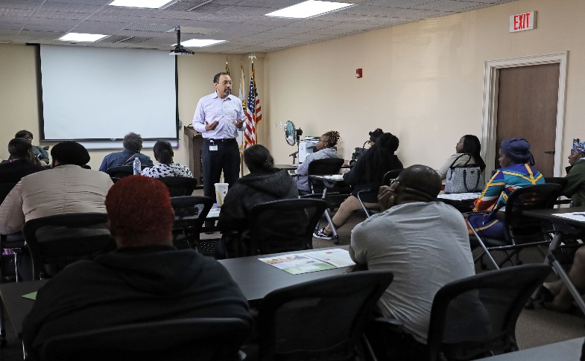

HOUSING AUTHORITY OF DEKALB COUNTY
DECATUR, GEORGIA
E.P. Pete Walker, Jr., Executive Director
  Pathways to Independence
  Youth Empowerment and Future Leaders Programs

Slide 16
BOISE CITY/ADA COUNTY HOUSING AUTHORITY
BOISE, IDAHO
Deanna L. Watson, Executive Director
  Annual Backpack Giveaway

Slide 17
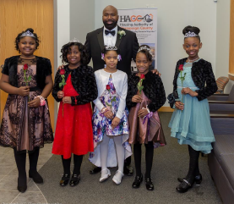
HOUSING AUTHORITY OF CHAMPAIGN COUNTY
CHAMPAIGN, ILLINOIS
David A. Northern, Sr, Executive Director/CEO
  A Princess Night Out
  Affordable Housing Panel Discussions
  Re-entry Transitional Housing Program

Slide 18
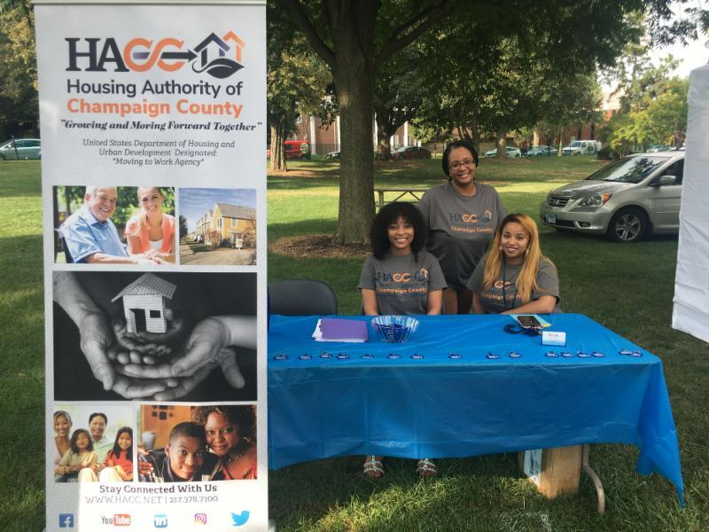
HOUSING AUTHORITY OF CHAMPAIGN COUNTY
CHAMPAIGN, ILLINOIS
David A. Northern, Sr., Executive Director/CEO
  The Creation of the HACC Enrichment Foundation
  The Employee Engagement Initiatives

Slide 19
RANDOLPH COUNTY HOUSING AUTHORITY
CHESTER, ILLINOIS
Chris Blechle, Executive Director
  Opportunity to Grow
WINNEBAGO COUNTY HOUSING AUTHORITY
ROCKFORD, ILLINOIS
Alan Zais, Executive Director
Re-Entry Program

Slide 20

ROCKFORD HOUSING AUTHORITY
ROCKFORD, ILLINOIS
Laura Snyder, Executive Director
  Wellness initiative for Seniors Meeting
  the Demand
HOUSING AUTHORITY OF THE CITY OF ELKHART, INDIANA
Terry Walker, Executive Director
  Washington Gardens Head Start
  Mitchell Craven

Slide 21
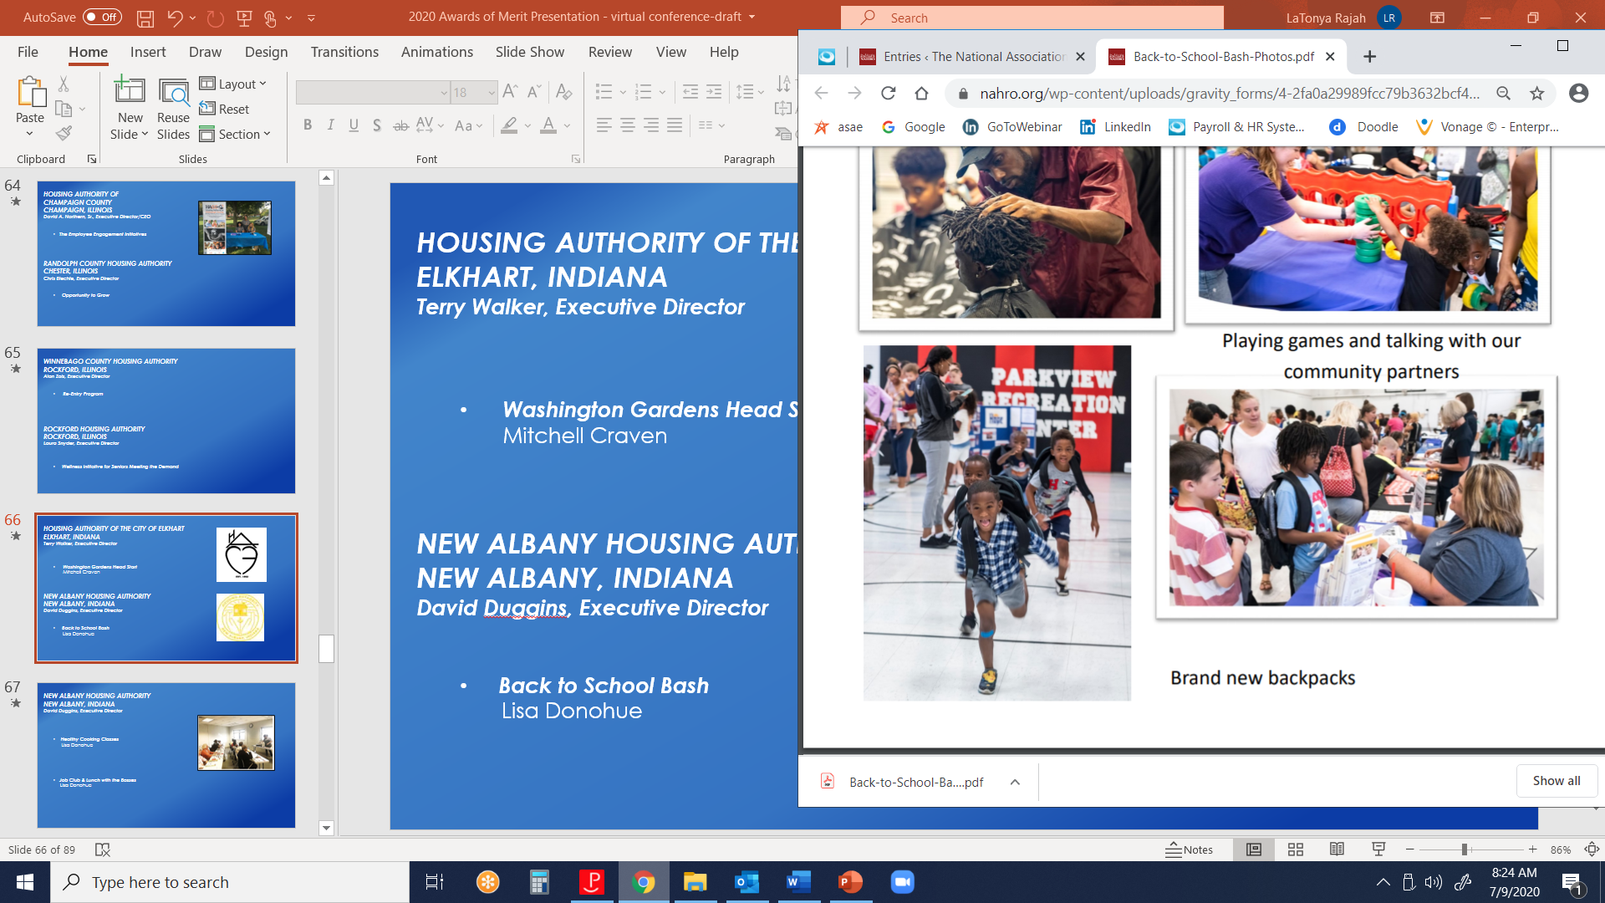
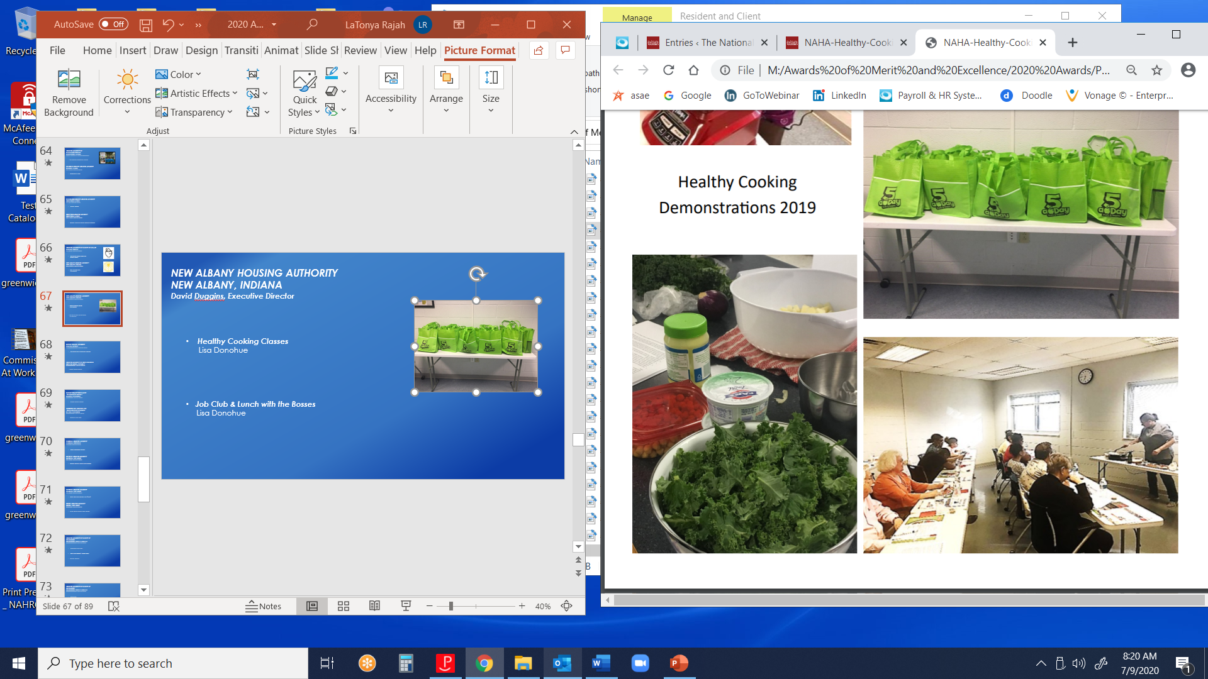
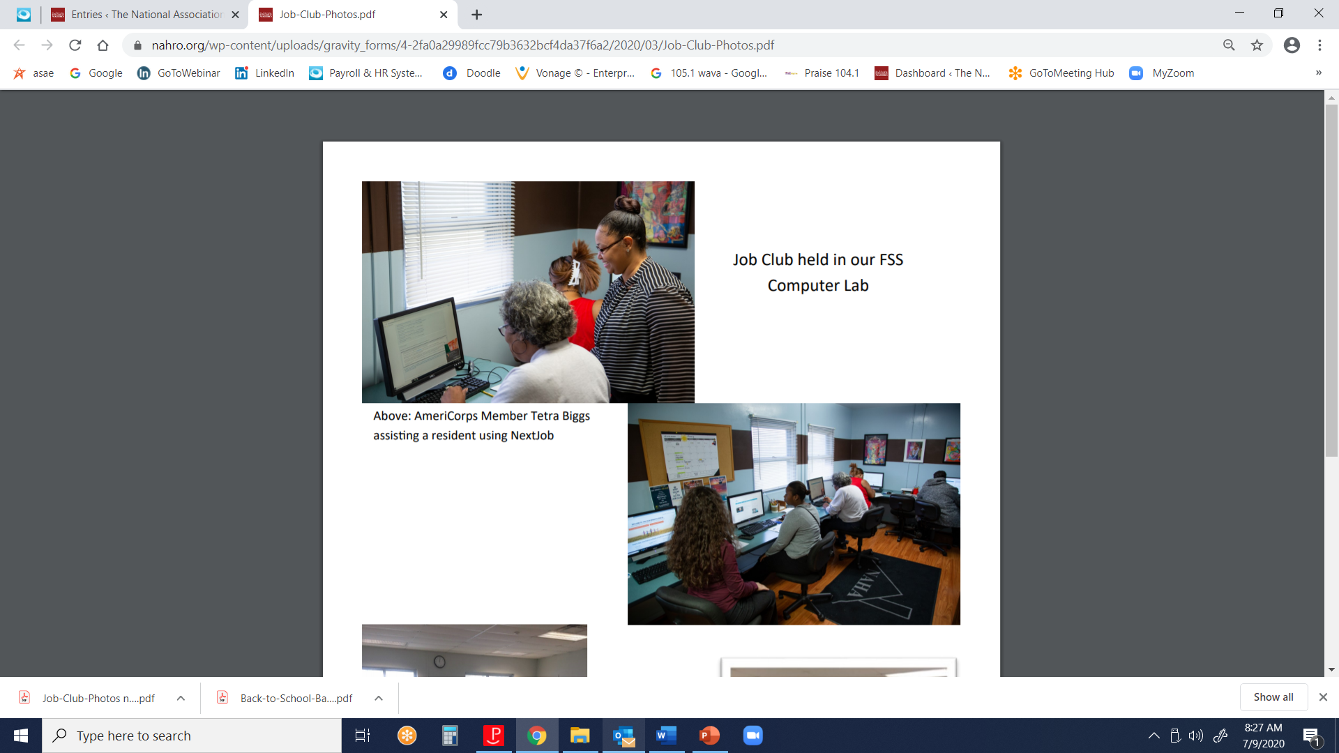
NEW ALBANY HOUSING AUTHORITY
NEW ALBANY, INDIANA
David C. Duggins, Jr., Executive Director
  Back to School Bash
  Lisa Donohue
  Healthy Cooking Classes
  Lisa Donohue
  Job Club & Lunch with the Bosses
  Lisa Donohue

Slide 22
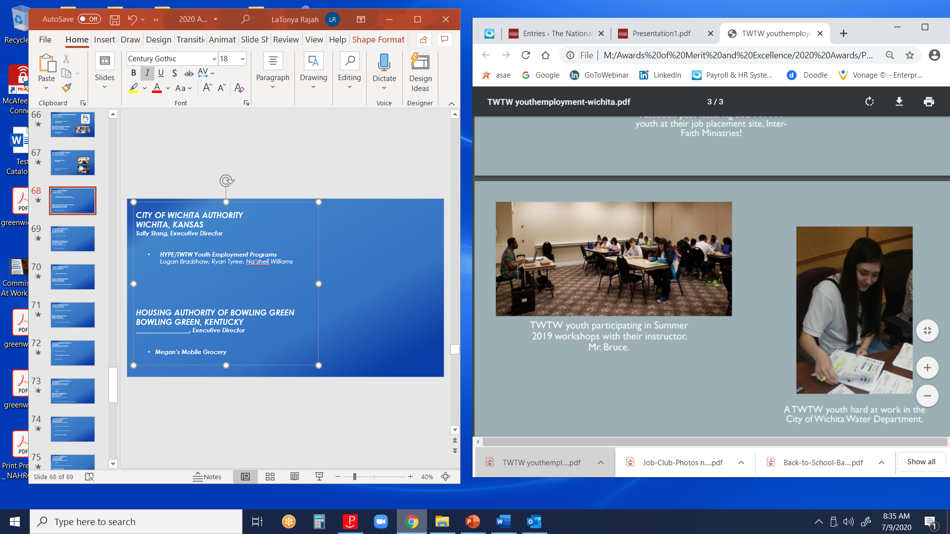
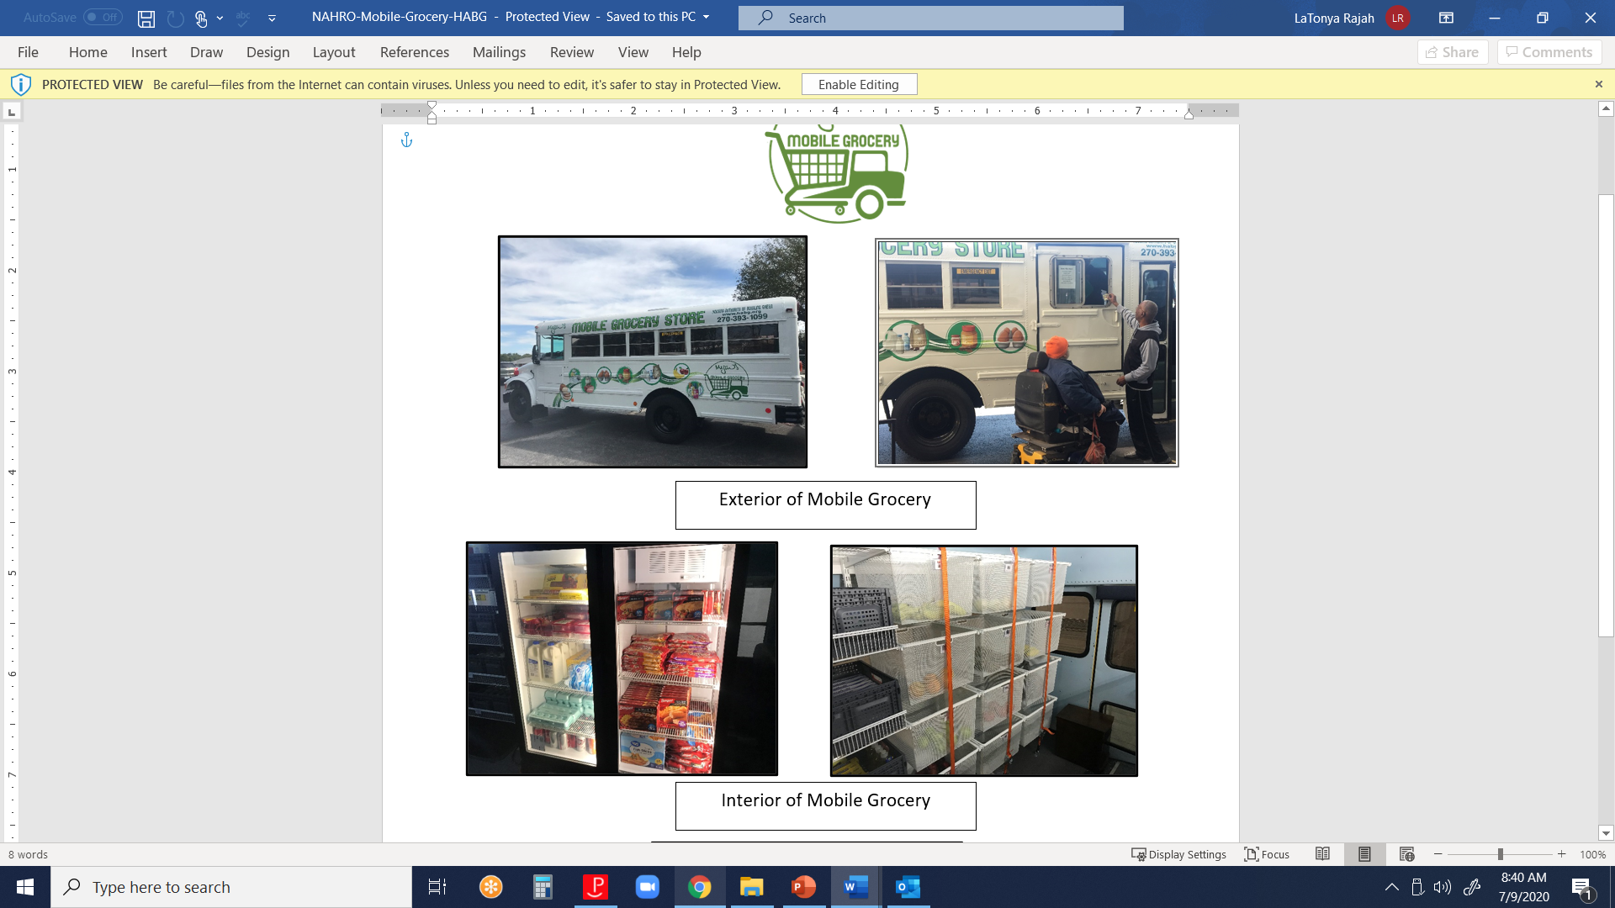
CITY OF WICHITA AUTHORITY
WICHITA, KANSAS
Sally Stang, Executive Director
  HYPE/TWTW Youth Employment Programs
  Logan Bradshaw, Ryan Tyree, Na’shell Williams
HOUSING AUTHORITY OF BOWLING GREEN, KENTUCKY
Abraham Williams, Executive Director
  Megan’s Mobile Grocery

Slide 23
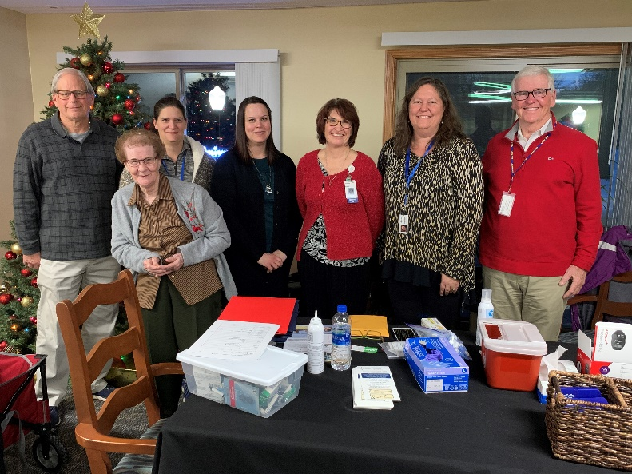
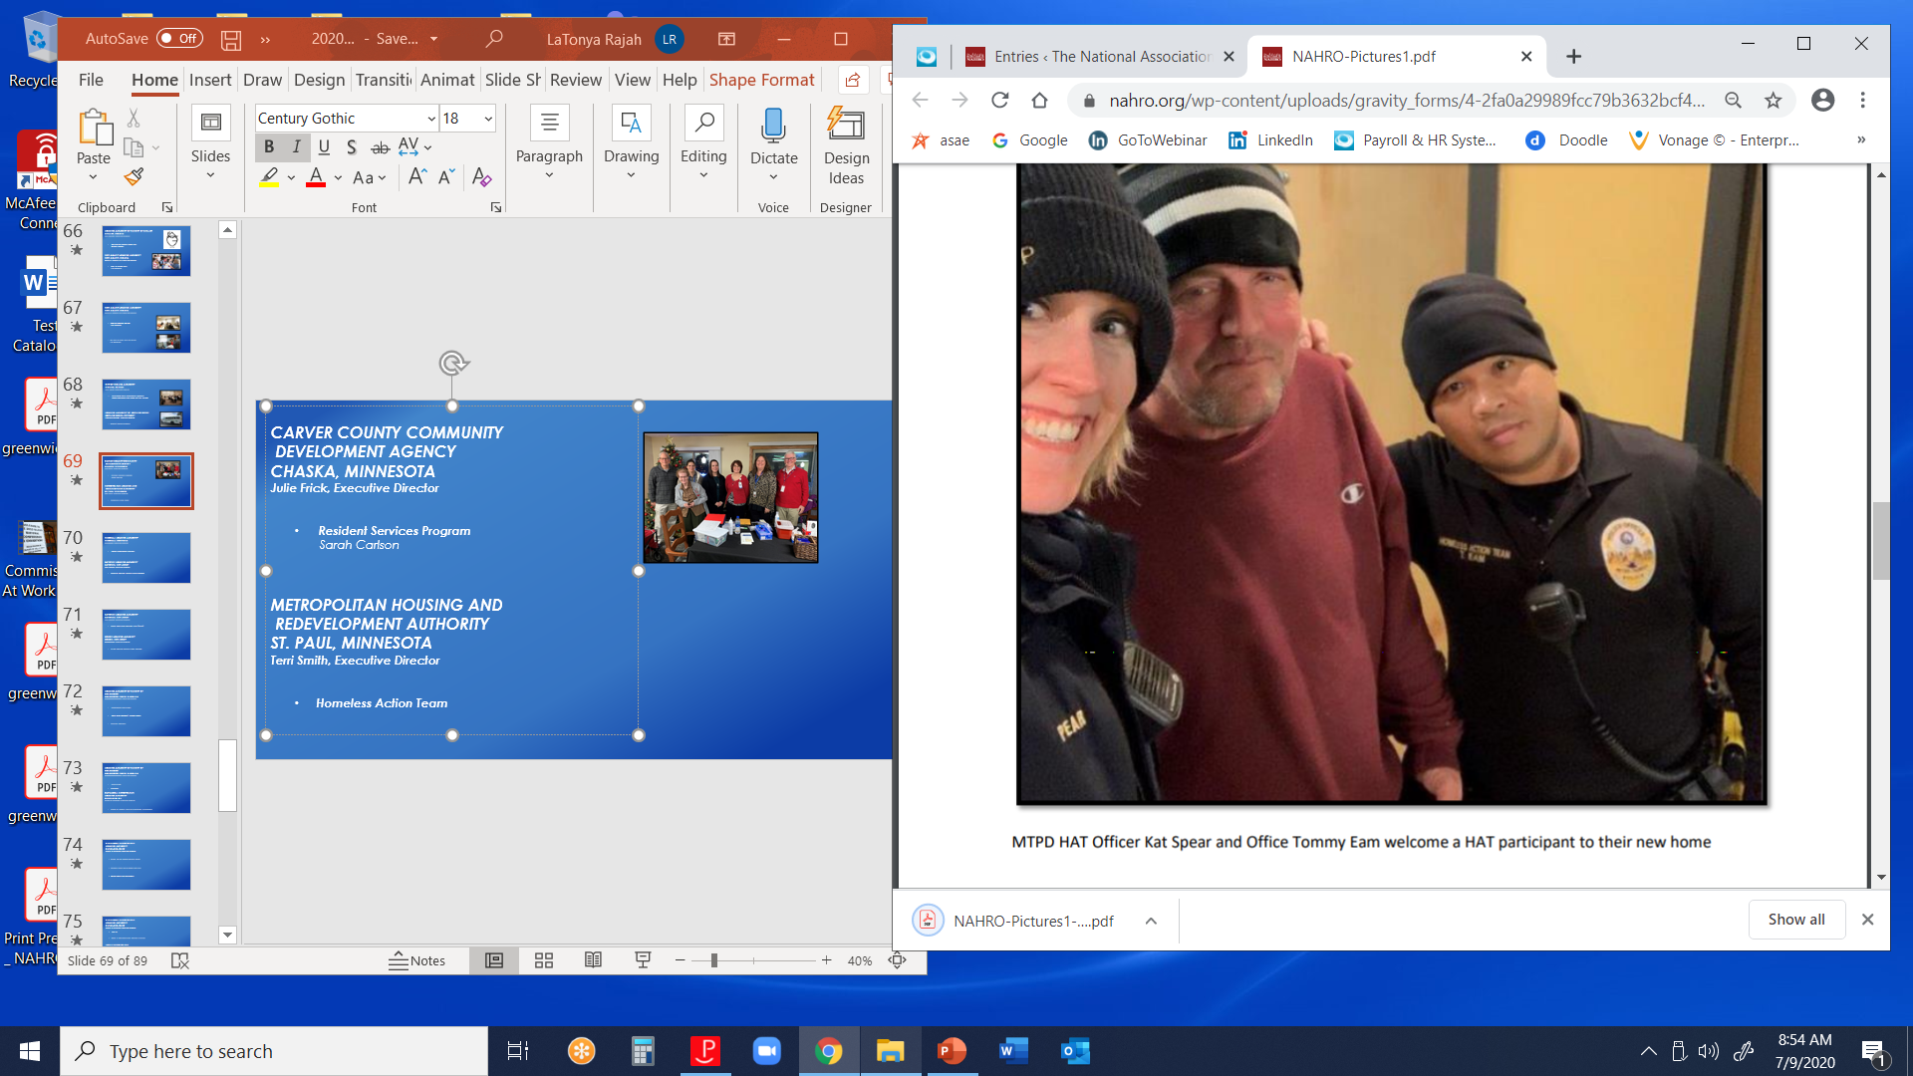
CARVER COUNTY COMMUNITY DEVELOPMENT AGENCY
CHASKA, MINNESOTA
Julie Frick, Executive Director
  Resident Services Program
  Sarah Carlson
METROPOLITAN HOUSING AND REDEVELOPMENT AUTHORITY
ST. PAUL, MINNESOTA
Terri Smith, Executive Director
  Homeless Action Team

Slide 24
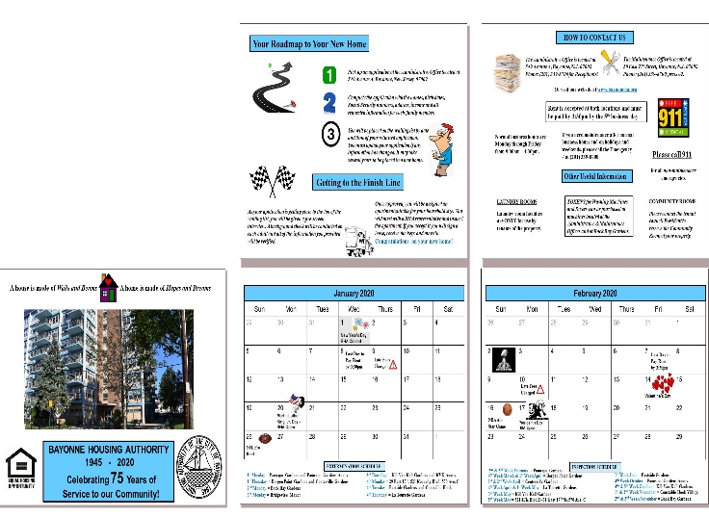
MISSOULA HOUSING AUTHORITY
MISSOULA, MONTANA
Lori Davidson, Executive Director
  Project Employment Connect
  Julie Clark, Sierra Lowney, Rebecca Stancil
BAYONNE HOUSING AUTHORITY
BAYONNE, NEW JERSEY
John T. Mahon, Executive Director
  Bayonne Housing Authority 2020 Calendar
  Senior Health and Resource Expo (SHARE)

Slide 25

EDISON HOUSING AUTHORITY
EDISON, NEW JERSEY
Deborah Hurley, Executive Director
  Edison Housing Authority Food Program
  Raquel Landero

Slide 26
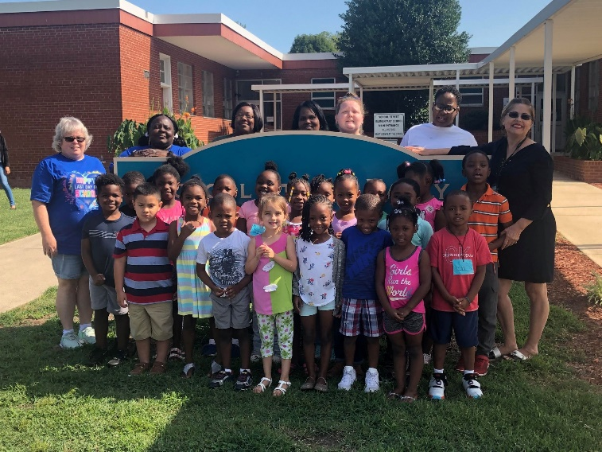
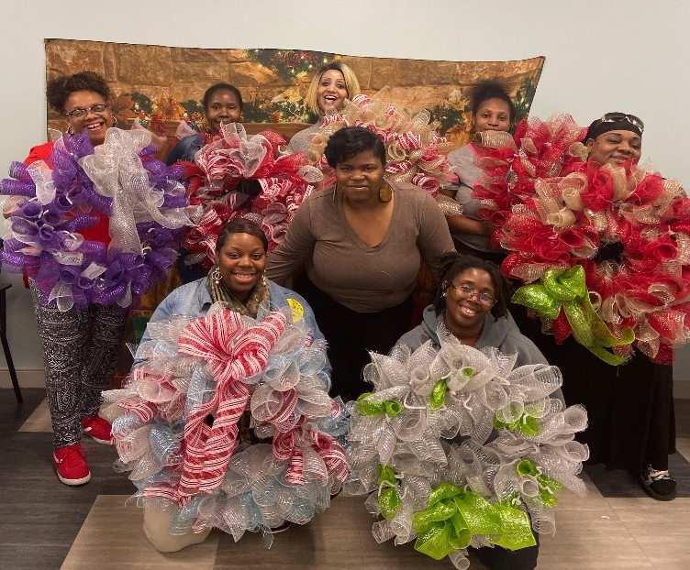
HOUSING AUTHORITY OF THE
CITY OF GOLDSBORO, NORTH CAROLINA
Anthony Goodson, Jr., CEO
  Kindergarten Boot Camp
  Housing Authority of the City of Goldsboro, Wayne
  Uplift Domestic Violence Support, A Caring Heart Case Management
  Pretty Tough Women’s Support Group
  Housing Authority of the City of Goldsboro, Wayne
  County Public Schools, City of Goldsboro

Slide 27

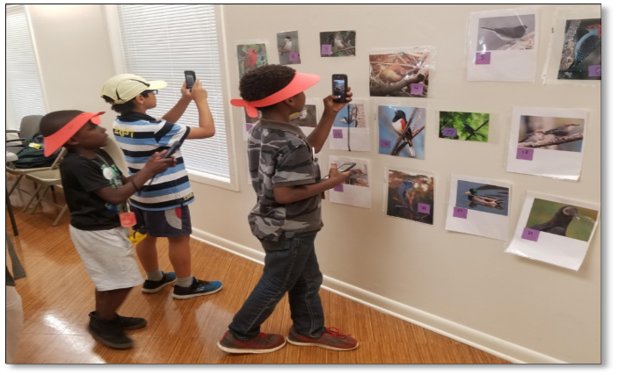
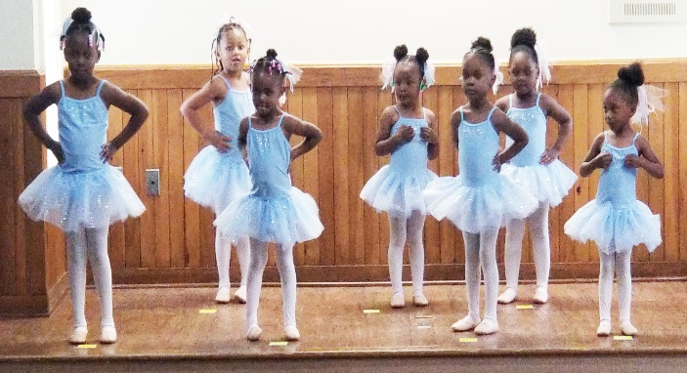
HOUSING AUTHORITY OF THE CITY OF GREENSBORO, NORTH CAROLINA
James Cox, Executive Director
  Dancing Dreamers
  Maggie Larkins
  Eco-Explore
  Maggie Larkins
  The Pre-Ballet Program
  Maggie Larkins

Slide 28

CUYAHOGA METROPOLITAN HOUSING AUTHORITY
CLEVELAND, OH
Jeffery K. Patterson, Chief Executive Officer
  CMHA Girl Scouts Lights On Afterschool Engagement
  CMHA PCs for People Eligibility Portal
  Resident Email Pilot at Cedar High Rise

Slide 29
CUYAHOGA METROPOLITAN HOUSING AUTHORITY
CLEVELAND, OH
Jeffery K. Patterson, Chief Executive Officer
  Techie Camp with TechCorps
  True 2U
  World B. Free Health and Wellness Initiative

Slide 30
LUCAS METROPOLITAN HOUSING AUTHORITY
TOLEDO, OHIO
Joaquin Cintron Vega, President and CEO
  Cooking with Commodities
ZANESVILLE METROPOLITAN HOUSING AUTHORITY
ZANESVILLE, OHIO
Steve Randles, Executive Director
  SNAP-ED Program

Slide 31

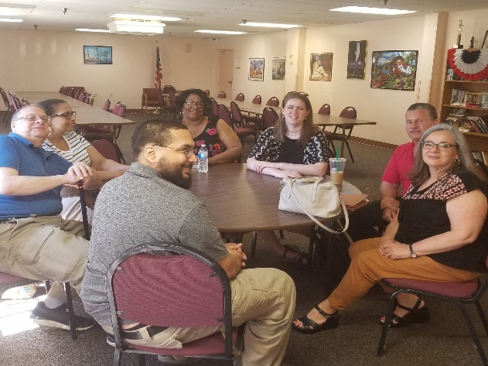
HOUSING AUTHORITY OF THE CITY
OF ERIE, PENNSYLVANIA
Michael R. Fraley, Executive Director
  Family Self-Sufficiency
ALLEGHENY COUNTY HOUSING AUTHORITY
PITTSBURGH, PENNSYLVANIA
Frank Aggazio, Executive Director
  Home Ownership Program
  Joe Benedetta, Joshua Benedetta, Felicia Benedetta
  Movie Nights

Slide 32
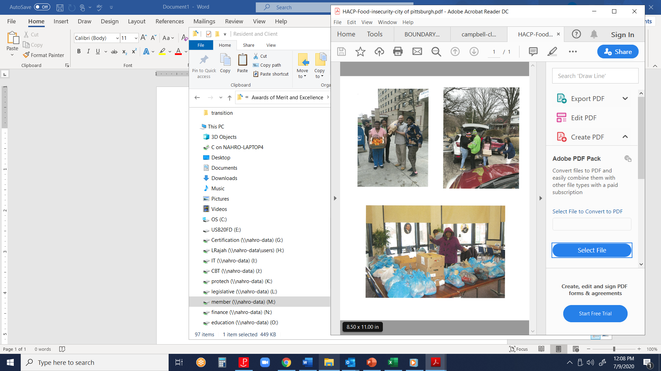
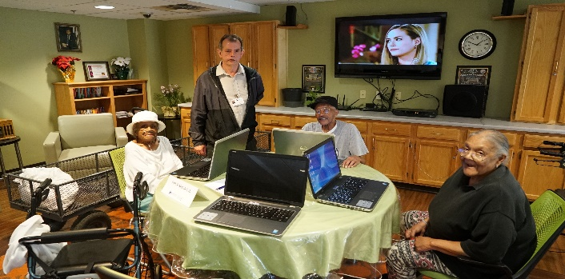
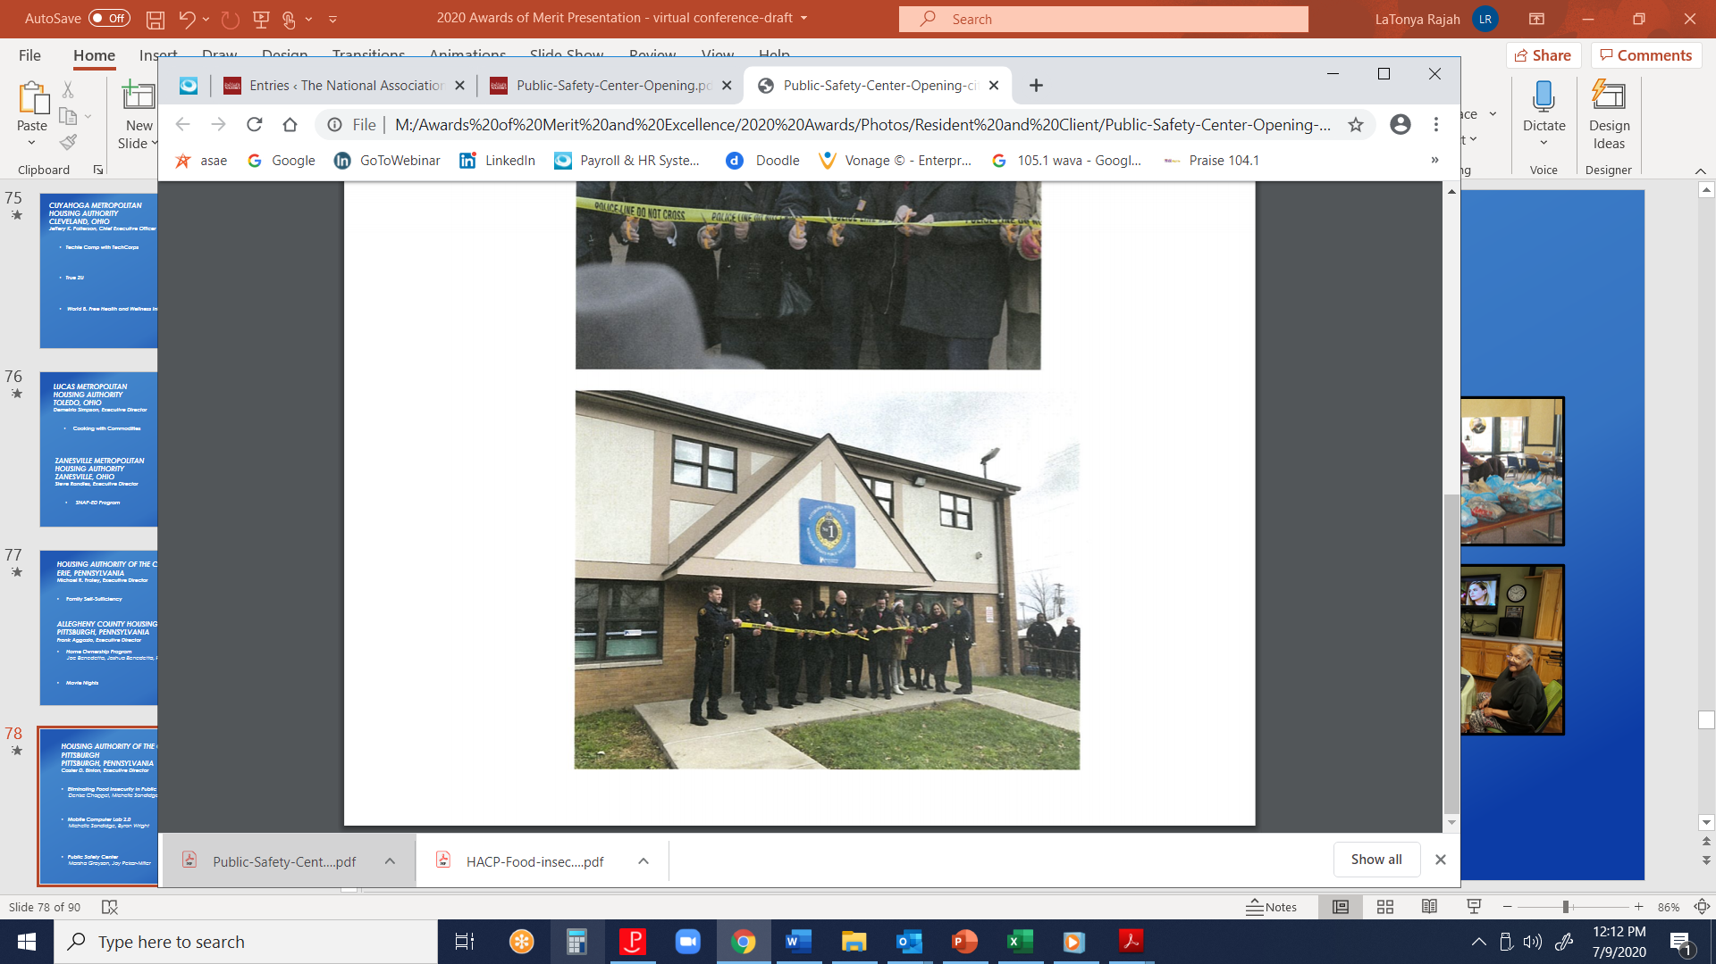
HOUSING AUTHORITY OF THE CITY OF PITTSBURGH, PENNSYLVANIA
Caster D. Binion, Executive Director
  Eliminating Food Insecurity in Public Housing
  Denise Chappel, Michelle Sandidge
  Mobile Computer Lab 2.0
  Michelle Sandidge, Byron Wright
  Public Safety Center
  Marsha Grayson, Joy Pekar-Miller

Slide 33
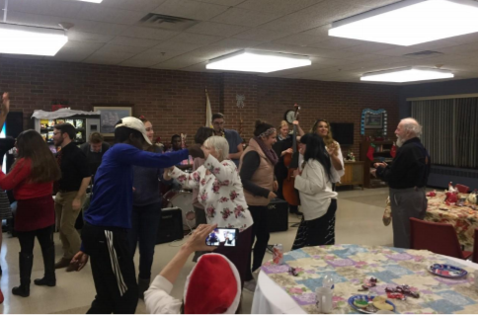
EAST GREENWICH HOUSING AUTHORITY
EAST GREENWICH, RHODE ISLAND
Marcia Sullivan, Executive Director
  NARCAN Initiative
NEWPORT HOUSING AUTHORITY
NEWPORT, RHODE ISLAND
Rhonda Mitchell, Executive Director
  Donovan Manor Health & Wellness Partnership

Slide 34
HOUSING AUTHORITY OF FLORENCE
FLORENCE, SOUTH CAROLINA
Clamentine V. Elmore, Executive Director
  Historical Black Colleges and
  Universities Fair
  Debra Faison, Chasidy Graham

Slide 35

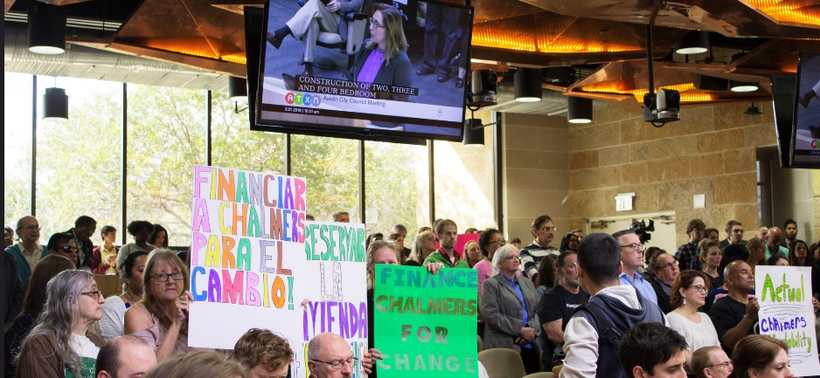
HOUSING AUTHORITY OF THE CITY OF AUSTIN
AUSTIN, TEXAS
Michael Gerber, President/CEO
  A Healthier, Happier Start for HACA’s Kids
  Support is Never Too Late or Too Far for HACA
  The Secret of RAD Success is Stellar Communication

Slide 36
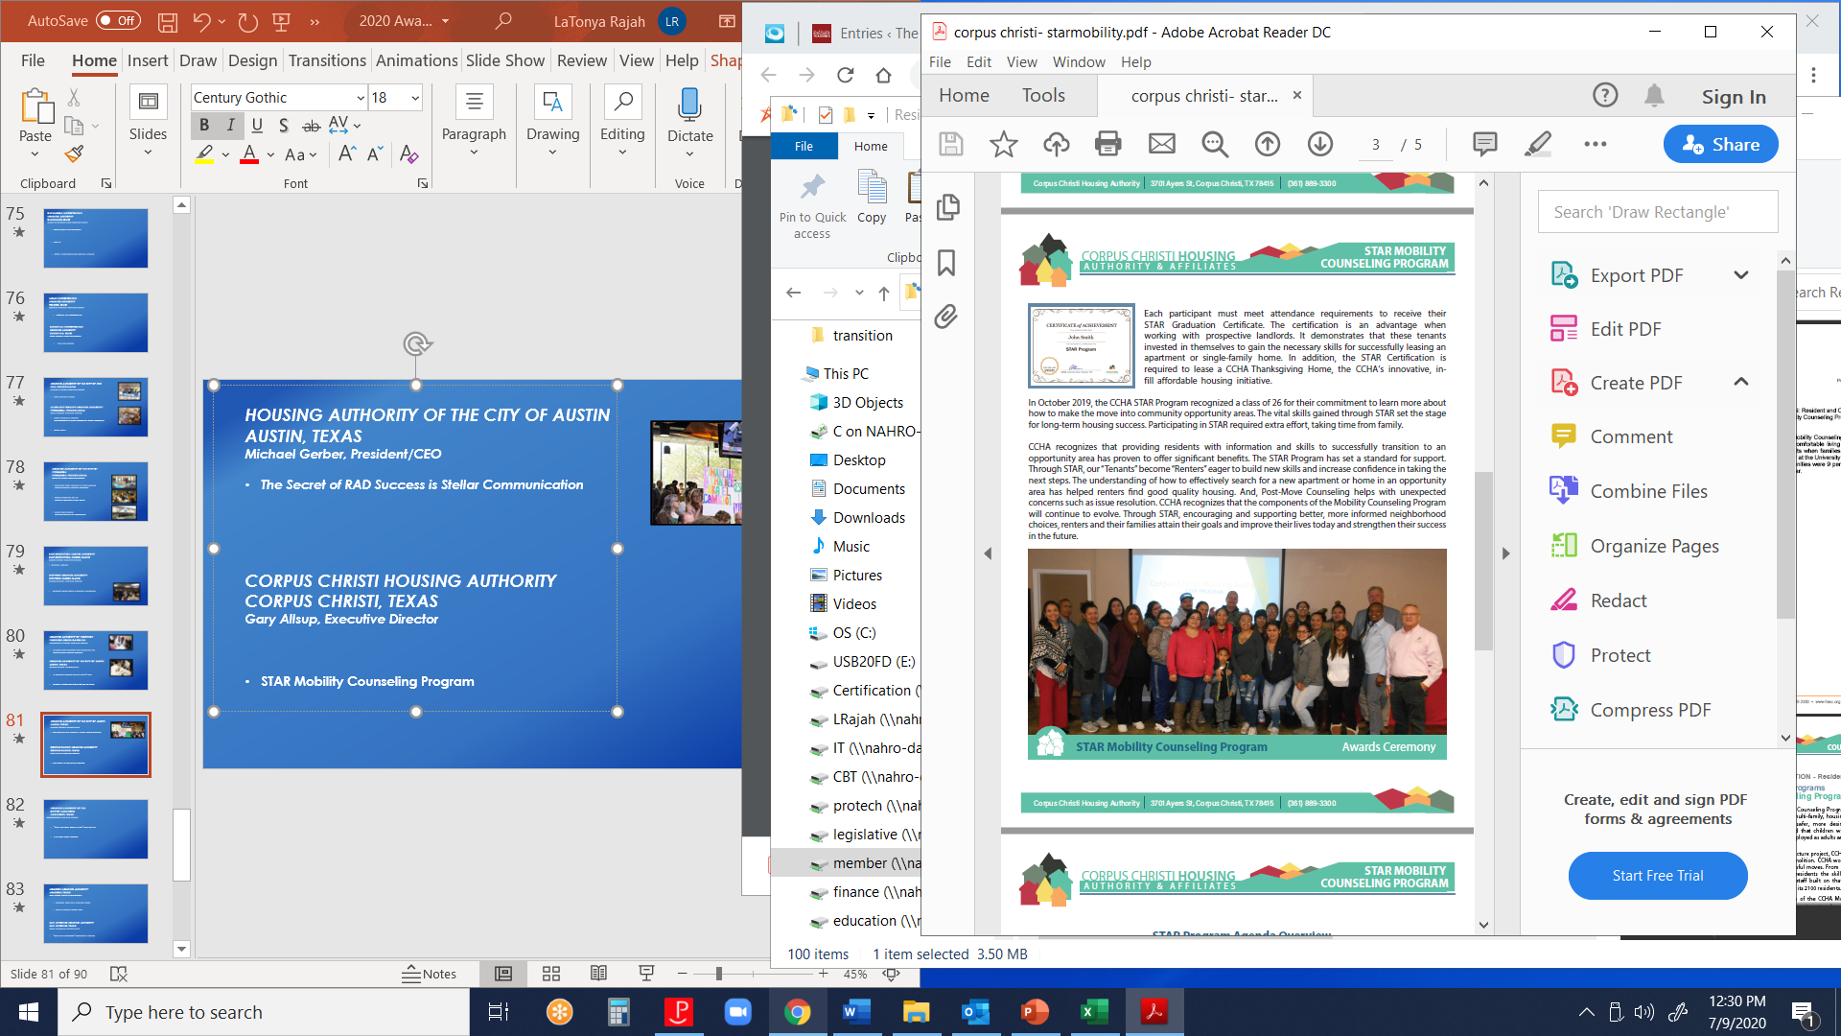
CORPUS CHRISTI HOUSING AUTHORITY
CORPUS CHRISTI, TEXAS
Gary Allsup, Executive Director
  STAR Mobility Counseling Program
HOUSING AUTHORITY OF THE CITY OF HARLINGEN, TEXAS
Hilda Benavides, Executive Director
  The “What Christmas Means to Me” Card Activity
  Charlie Perez, Vanessa Sema
  Little Free Library Program
  Charlie Perez, Vanessa Sema

Slide 37
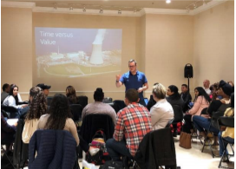
HOUSTON HOUSING AUTHORITY
HOUSTON, TEXAS
Mark Thiele, Interim CEO/President
  Common Goals for a Common Good
  Pop Up Business School Effort

Slide 38

SAN ANTONIO HOUSING AUTHORITY
SAN ANTONIO, TEXAS
David Nisivoccia, President/CEO
  Walk with a Manager” Community Initiative
  Family Self-Sufficiency Financial Literacy
  Garcia Street Urban Farm
  HUD Jobs Plus

Slide 39
SAN ANTONIO HOUSING AUTHORITY
SAN ANTONIO, TEXAS
David Nisivoccia, President/CEO
  HUD Jobs Plus – Mega Job Fair
  Keep it Clean- Housekeeping Training
  Mother’s Day Celebration
  Parenting With a Purpose

Slide 40

HOUSING AUTHORITY OF THE COUNTY OF HIDALGO
WESLACO, TEXAS
Mike Lopez, Executive Director
  Creating a Better Summer School
HOUSING CONNECT SALT LAKE
CITY, UTAH
Janice Kimball, Chief Executive Officer
  Families BOND
  Cassandra Meyers, Krysta Kniemczyk

Slide 41

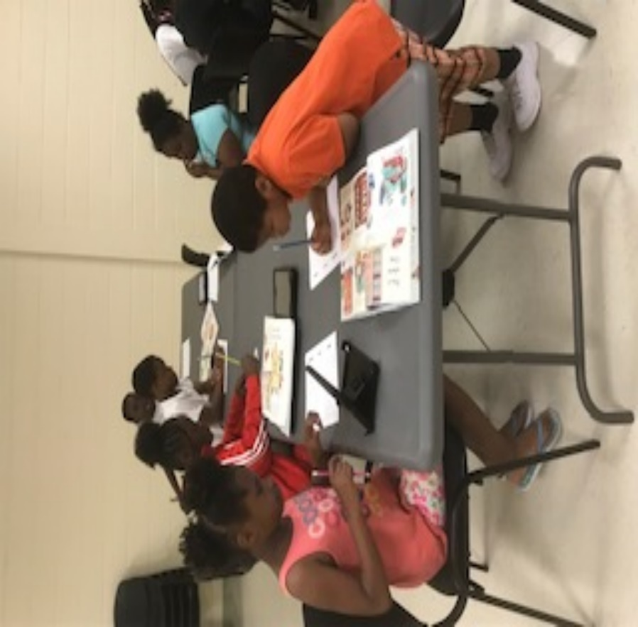
NORFOLK REDEVELOPMENT AND HOUSING AUTHORITY
NORFOLK, VIRGINIA
John Kownack, Executive Director
  NRHA’s Trunk or Treat Halloween Event
PORTSMOUTH REDEVELOPMENT AND HOUSING AUTHORITY
PORTSMOUTH, VIRGINIA
Edward Bland, Executive Director
  The Olori Academy

Slide 42

HOUSING AUTHORITY OF THE CITY OF BREMERTON, WASHINGTON
Tim Schanne, Interim Executive Director
  Community Connections Team
  Charlette Reily, Tasha Walton, Carol Zborowski
YAKIMA HOUSING AUTHORITY
YAKIMA, WASHINGTON
Lowel Krueger, Executive Director
Supported Employment Program

Slide 43
Congratulations
to the
2020 Awards
of Merit Winners !
♦♦♦

