Slide 1
Online Schedules and Logistics Overview

Slide 2
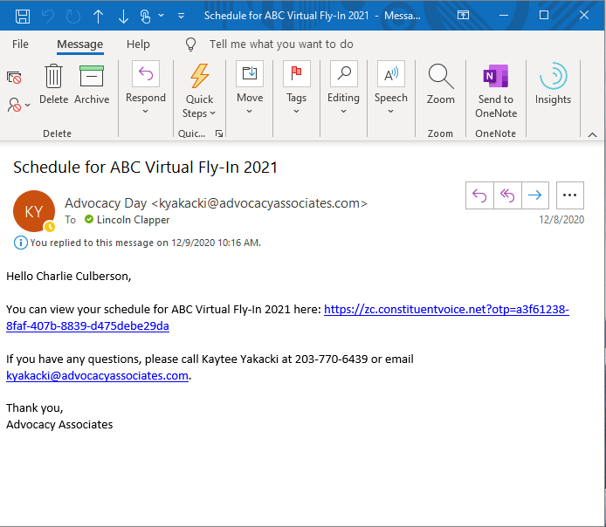
Receiving Your Schedule
You will receive an automated email from Advocacy Associates on a to-be-determined date by your organization
Click on the URL to access your schedule. You will be automatically logged in when clicking on the URL
Check your SPAM/JUNK folder if you think you did not receive the email
Verify with your organization on the date schedules were/will be sent
Follow your email platform’s instructions for unmarking future correspondence as spam, if needed

Slide 3
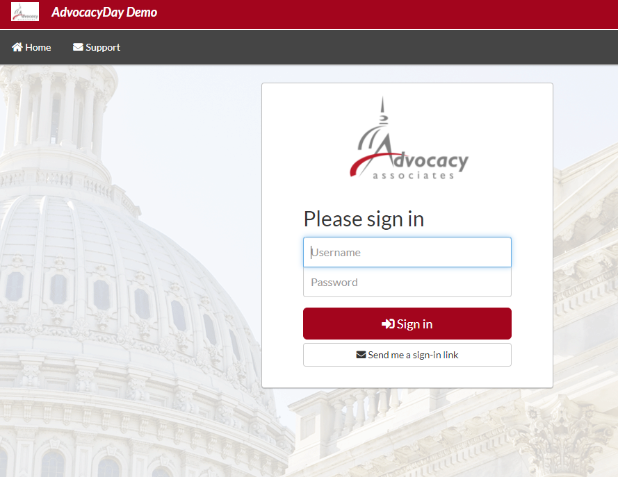
Not Able to Login?
If you are not able to login or become logged out at any point, you will land at a login page

Slide 4
Not Able to Login?
If you are not able to login or become logged out at any point, you will land at a login page
Select “Send me a sign-in link” – do not try to enter a username or password

Slide 5
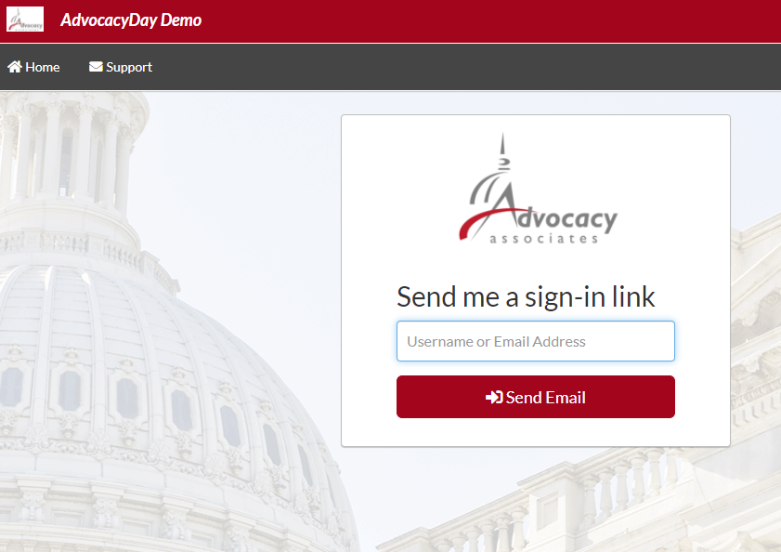
Not Able to Login?
If you are not able to login or become logged out at any point, you will land at a login page
Select “Send me a sign-in link” – do not try to enter a username or password
Input the email you registered for the event with to receive a new link to your schedule

Slide 6
Not Able to Login?
If you are not able to login or become logged out at any point, you will land at a login page
Select “Send me a sign-in link” – do not try to enter a username or password
Input the email you registered for the event with to receive a new link to your schedule
If the problem persists, click on the Support tab, fill out the questionnaire, and Advocacy Associates will contact you shortly

Slide 7
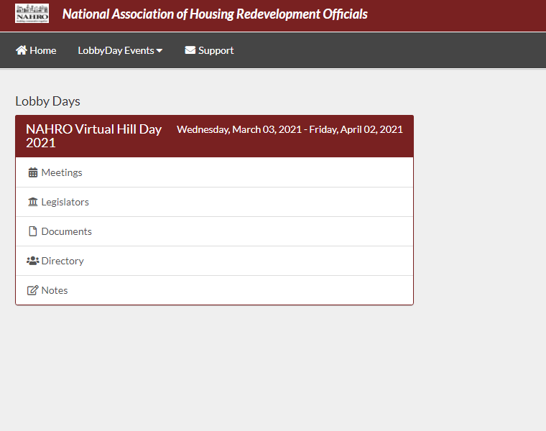
Main Schedule Page
Select the Meetings Tab from your home page

Slide 8
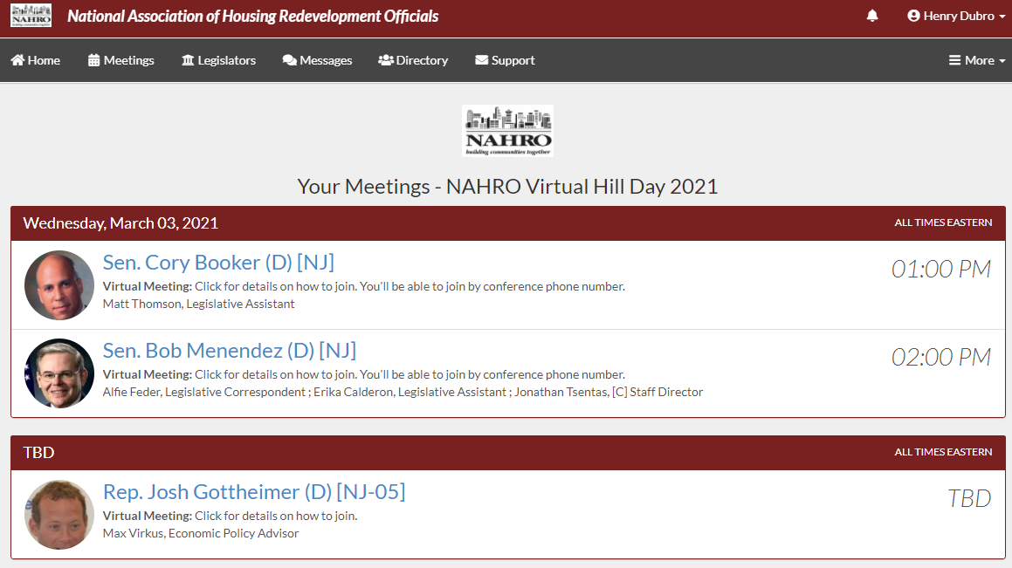
Main Schedule Page
Confirmed meetings display on the top

Slide 9
Main Schedule Page
Confirmed meetings display on the top
Pending meetings display on the bottom

Slide 10
Main Schedule Page
Confirmed meetings display on the top
Pending meetings display on the bottom
All times will be displayed as EASTERN

Slide 11
Main Schedule Page
Confirmed meetings display on the top
Pending meetings display on the bottom
All times EASTERN
Click on each meeting to access the information

Slide 12
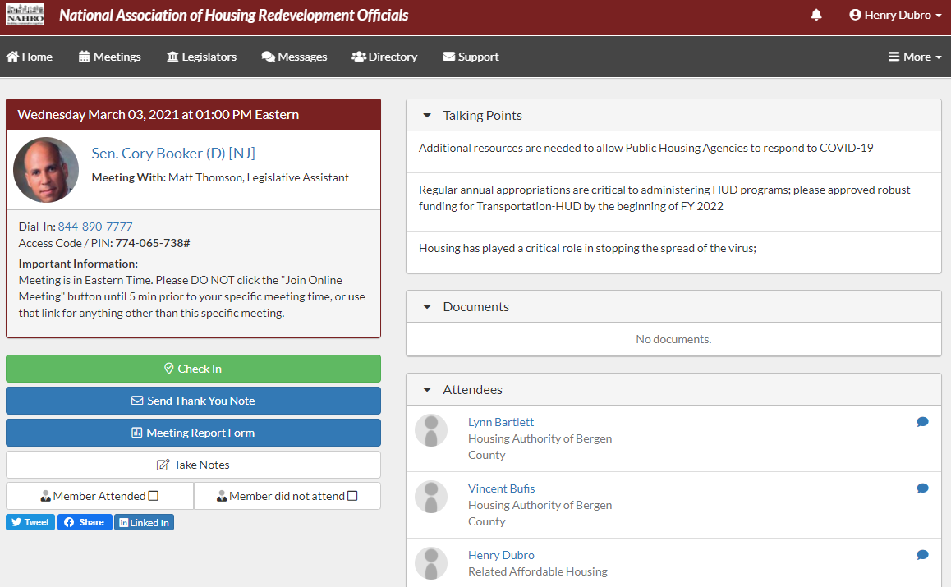
Date and Time

Slide 13
Date and Time
Meeting With

Slide 14
Date and Time
Meeting With
Dial-in/additional information

Slide 15
Date and Time
Meeting With
Dial-in/additional information
If there is a video component, click “Join Online Meeting” to open video component. If the button is not available, then there is no video component

Slide 16
Talking Points

Slide 17
Talking Points
Documents (click to open in separate tab)

Slide 18
Talking Points
Documents (click to open in separate tab)
Attendees who are in the meeting

Slide 19
Talking Points
Documents (click to open in separate tab)
Attendees who are in the meeting
Peer-to-peer chat function

Slide 20
Talking Points
Documents (click to open in separate tab)
Attendees who are in the meeting
Peer-to-peer chat function
Check-in to report attendance

Slide 21
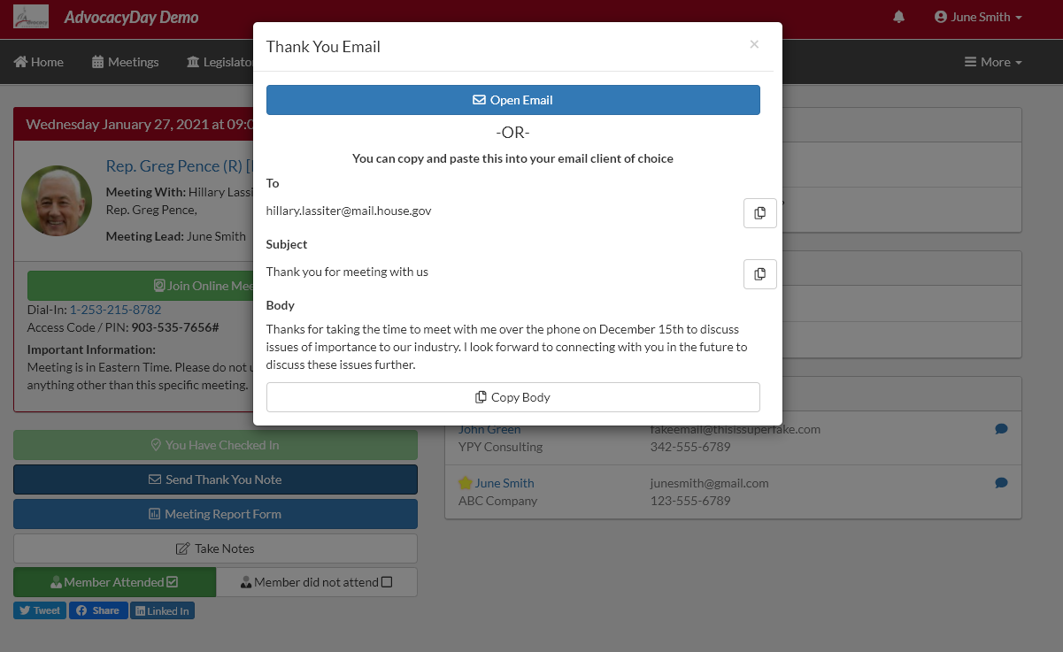
Talking Points
Documents (click to download as PDF)
Attendees who are in the meeting
Peer-to-peer chat function
Check in to report attendance
Thank You email. Open the email with your native platform or copy paste into Gmail, Yahoo, AOL etc.

Slide 22
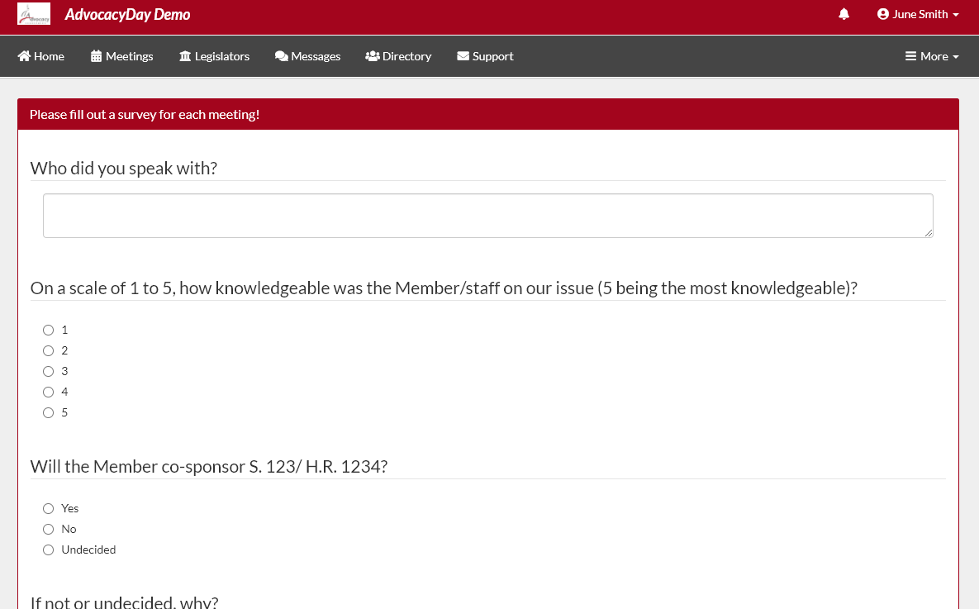
Meeting Report Form, scroll down to answer each question

Slide 23
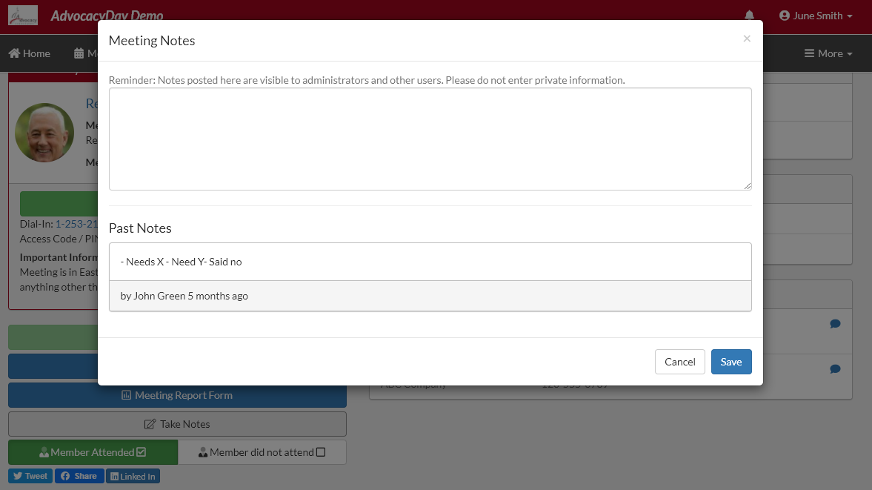
Take Notes option (blank notepad)

Slide 24
Take Notes option (blank notepad)
Member of Congress attendance, check one

Slide 25
Take Notes option (blank notepad)
Member of Congress attendance, check one
Social Media share buttons

Slide 26
Take Notes option (blank notepad)
Member of Congress attendance, check one
Social Media share buttons
Click on Meetings tab to access main page again

Slide 27
Take Notes option (blank notepad)
Member of Congress attendance, check one
Social Media share buttons
Click on Meetings tab to access main page again
Click Legislators tab to access more information

Slide 28
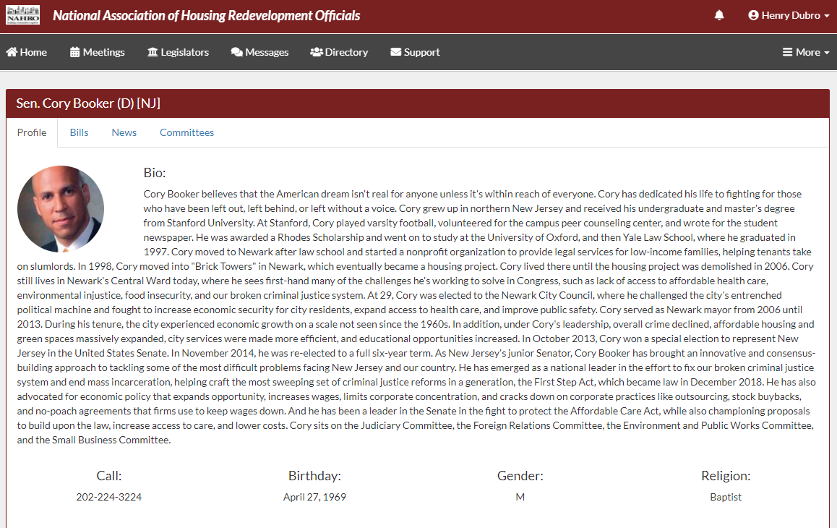
Bio and social media contact information

Slide 29
Bio and social media contact information
Relevant bills with voting record

Slide 30
Bio and social media contact information
Relevant bills with voting record
Recent news mentions

Slide 31
Bio and social media contact information
Relevant bills with voting record
Recent news mentions
Committee assignments

Slide 32
Messages tab to access peer-to-peer messages
Directory tab to contact any attendee in your event
Support tab for scheduling or technical assistance

Slide 33
Click the “More” tab to access additional materials, information, and resources that your organization may have provided

Slide 34
Relevant Information and Reminders
Check your SPAM/JUNK folder to ensure you didn’t miss the email with the link to your schedule (domain is @advocacyassociates.com)
Please call/video into the meeting 5 minutes prior to the start time, in order to discuss with your group on who will open the conversation and who will be speaking
All times will be Eastern Time (New York Time Zone)
You will receive a reminder email 1 hour prior to each meeting from Advocacy Associates with a link to your schedule
If the office does not join the meeting within 10 minutes past the start time, contact Advocacy Associates
There will be a help number listed in the Support tab to call if you need to get ahold of Advocacy Associates
Meetings are scheduled for 15 minutes blocks. They may end early or go longer, but the time frame remains the same as an in-person meeting
Any changes to your schedule the day of the event will be sent to you via email. Please be sure to check regularly throughout the day
Make sure you are in an area with a good Wi-Fi connection
Mute your microphone if you are not speaking
Know your audience - ensure you have an appropriate background

Slide 35
Online Schedules and Logistics Overview

