Slide 1
NAHRO Presents
What to Know Before You “Go” to Capitol Hill

Slide 2
agenda
NAHRO Virtual Washington Conference, Hill Day Overview
Logistics
Preparing for Your Meetings

Slide 3
Today’s Presenters
Tess Hembree
Director of Congressional Relations
NAHRO
Lincoln Clapper
Chief Sales Officer
Advocacy Associates

Slide 4
Overview: What is virtual hill day?
NAHRO Virtual Washington Conference Attendees meet with members of Congress via conference call
Hear from Congressional staff and members of Congress
Opportunity to connect with Washington, DC-based legislators and staff
Highlight NAHRO affordable housing and community development priorities
TELL YOUR STORY

Slide 5
NAHRO online Washington conference- Tuesday, March 2
Opening Plenary: Major Garrett
11:15 am – 12:15 pm
Concurrent Session: Advocacy Tips and Insights
12:30 pm – 1:30 pm
Plenary Session: Washington Report
3:00 pm – 4:30 pm

Slide 6
NAHRO online conference, Hill Day- Wednesday, March 3
Congressional Staff Panel
9:00 am- 10:00 am
Members of Congress, Legislator of the Year
11:15 am – 12:15 pm
Meetings with Your Legislators
Various times, 9:00 am – 4:00 pm
Reception
4:00 pm- 5:00 pm

Slide 7
Overview: How do I schedule meetings?
You don’t! We will
Constituency based on registration address
Ensure everyone from state, district meet with office together
Coordinate with others from state

Slide 8
logistics
Lincoln Clapper
Chief Sales Officer
Advocacy Associates

Slide 9
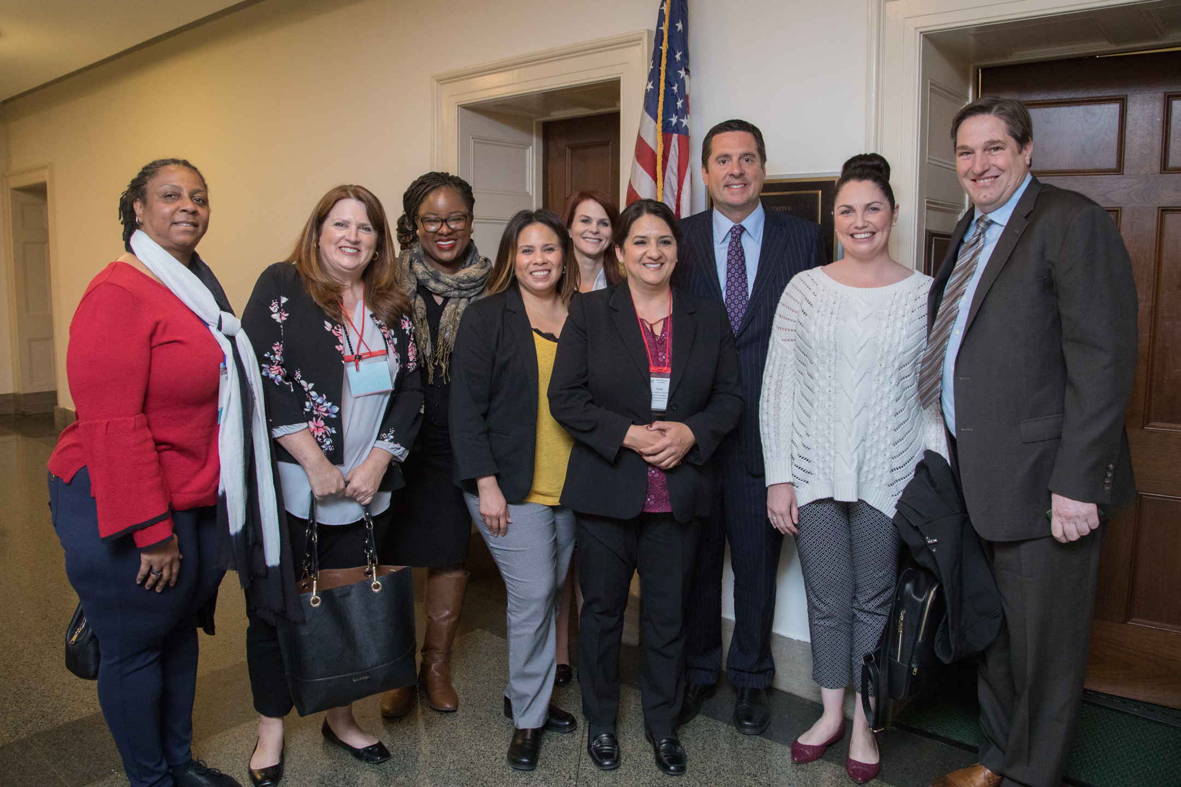
Introduction to advocacy
WHY PARTICIPATE?
Advocacy IS….
Actions taken to promote more informed decision making at the federal, state, and local levels by:
Generating a better understanding of the role of housing and community development programs in peoples’ lives
Working within your established agency policy and legal restrictions
Two types of Advocacy:
Ongoing, year-round, mission-driven
Issue/Event-Specific

Slide 10
Preparing for your meetings: Teleconference basics
Dial in 5 minutes early
Begin with introductions of all participants
Know who will speak when
Wrap up within 15-30 minutes (ask at beginning of call)

Slide 11
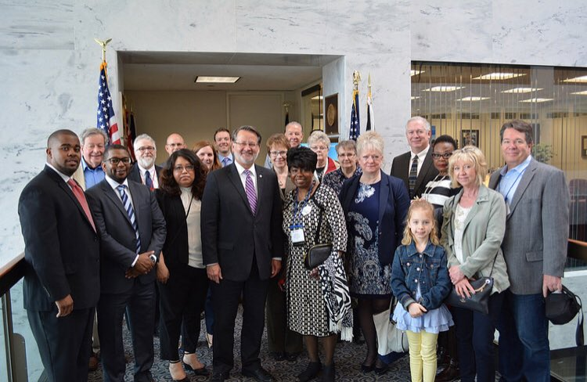
Preparing for your meetings
Prepare an agenda of items you wish to discuss and related talking points for your use during your meeting
Be specific; don’t try to cover too much
Assign roles if going in group
Spell out what you want from member of Congress
Provide NAHRO materials
Provide information on Your Agency
BE PERSONAL- they want to know what is happening in the state/district
Notes:
I have handouts

Slide 12
Homework Assignment
Who you’re talking to
Visit websites (house.gov, senate.gov)
Check out what bills they’ve introduced (www.congress.gov)
Sign up for their e-newsletters
Check their views on www.votesmart.org
Check their campaign situation on www.opensecrets.org
Connect via social media
Pick one or two -- no need to be overwhelmed!

Slide 13
Who You’re Talking To: Some Notes on Staff Meet With Them!)
THANK THEM- many worked in the DC office during coronavirus, January 6
Remember, Your Issue Is One of Many
Staff Contact Has Advantages Over Member Contact
Institutional Memory in an Elected Official’s Office Can Be Short
Expect (and Appreciate) Youth
Ultimately, represent their boss

Slide 14
Meetings during COVID-19, January 6 crisis
Ask how staff, legislators are doing
Thank them for serving state/district
Tell the story of what is happening in your community
You don’t have to be policy expert, but you are an expert in affordable housing, community development in your state/district

Slide 15
2021 legislative and regulatory agenda

Slide 16
2021 nahro legislative and regulatory agenda: policy priorities
Fully Fund Affordable Housing and Community Development Programs
Champion Resilient Families and Communities
Support Local, Equitable Community-Based Solutions
Preserve and Develop the Nation’s Housing Stock

Slide 17
2021 nahro legislative and regulatory agenda: policy priorities

Slide 18
2021 NAHRO Legislative and regulatory agenda: Talking points

Slide 19
Questions?
Tess Hembree
Director, Congressional Relations
NAHRO
thembree@nahro.org

